Slide 1
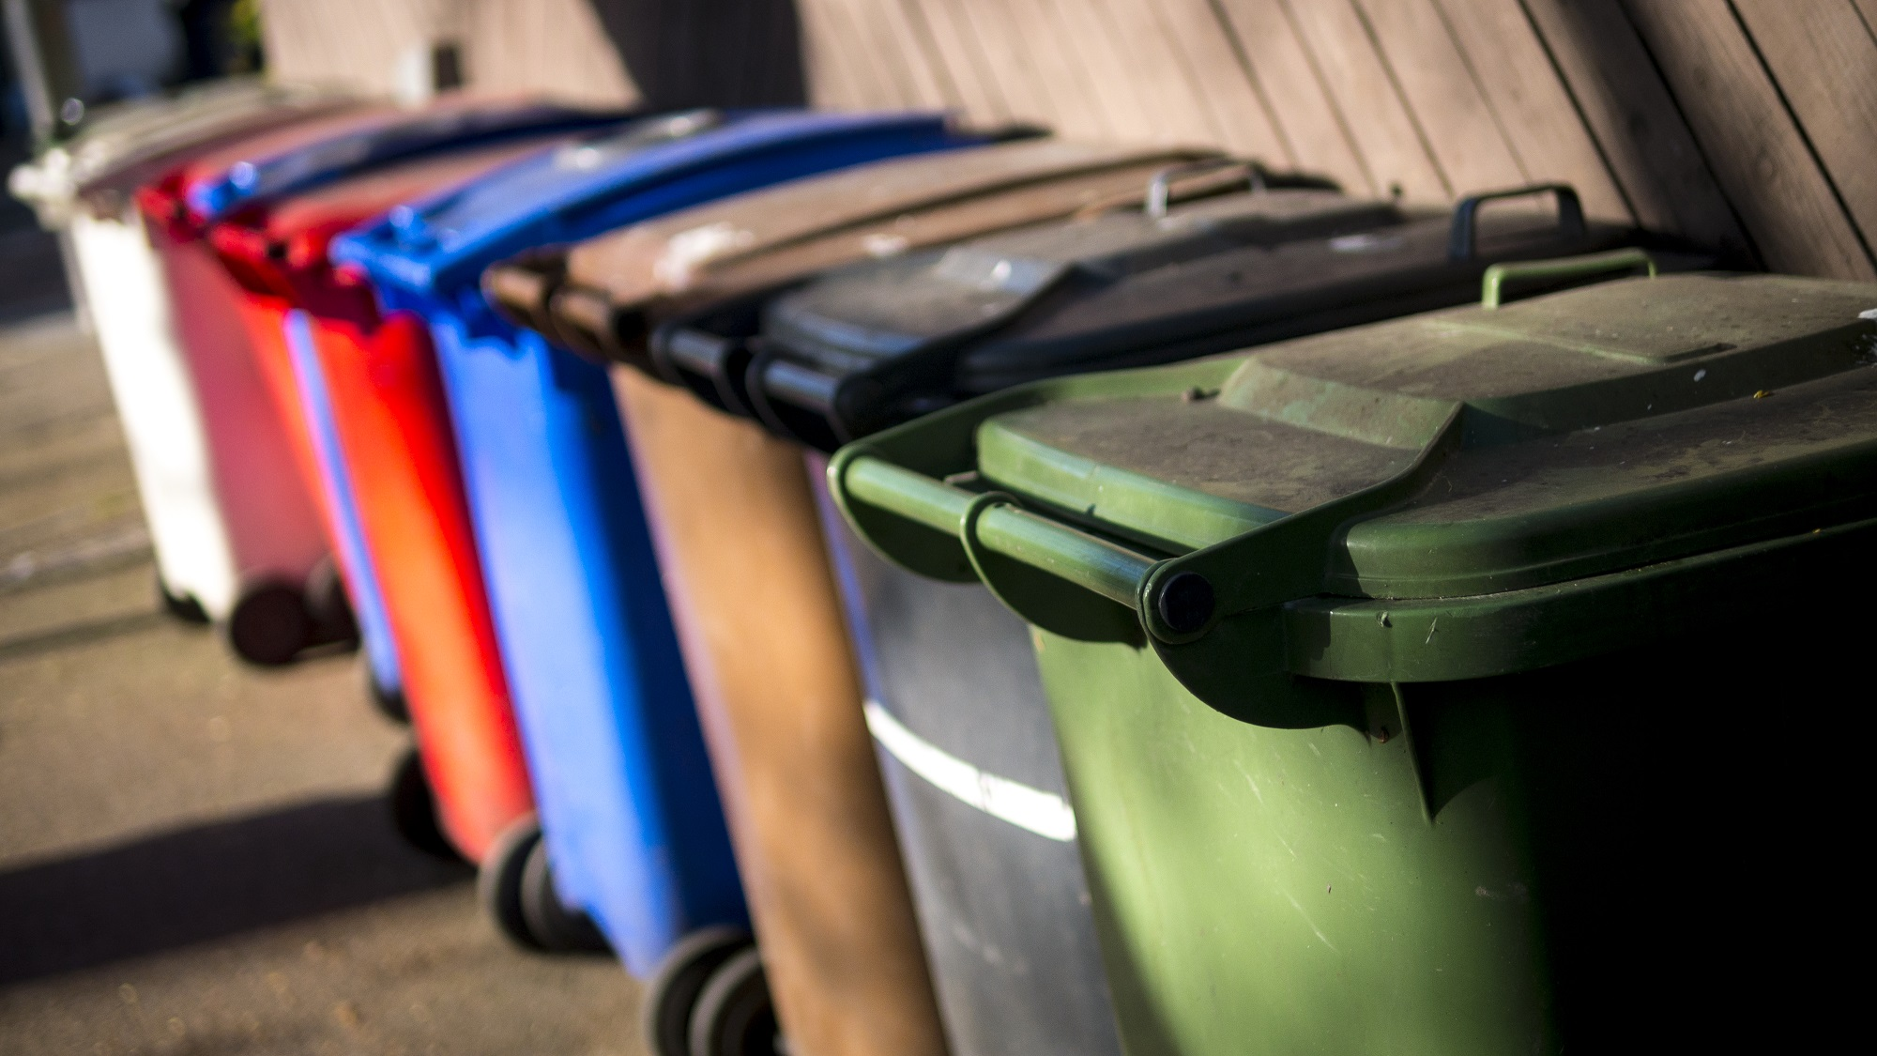
KLU Design Thinking for Innovation Project Title: Waste Management
Department CS&IT Section 03 Batch 06 Date 26/04/2022

Slide 2

Project Team -Introduction
S.NO | NAME | ID NUMBER | ROLE IN THE PROJECT
1 | Wajid Ali | 2100090052 | Breakout Activities
2 | A. Hemanth | 2100090112 | Survey
3 | Rupesh | 2100090119 | Interviewer
4 | N. Jahnavi | 2100090120 | Designer
5 | Narashimha | 2100090121 | Data Processor
6 | Srinija | 2100090122 | Designer
7 8 | Brahmini Chowdary Ziya Afreen | 2100090127 2100090133 | Breakout Activities Representer
10 11 12 | K. Hemanth Kumar Rahul Varma Mohith Vardhan | 2100090136 2100090141 2100090142 | Group Leader Survey Designer
13 | MD Saif | 2100090144 | Breakout Activities

Slide 3
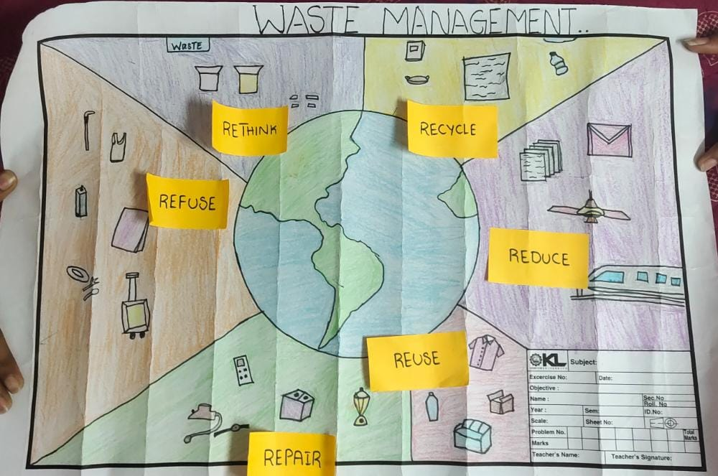
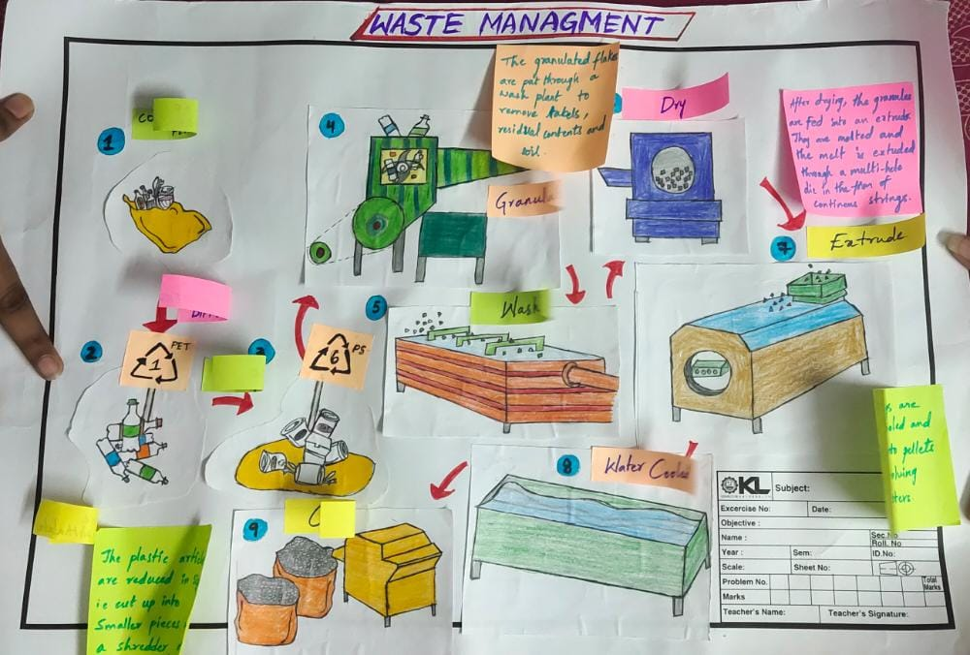
Rough Prototype:

Slide 4
Our Most Important Learnings
Garbage is a material or solid object that is no longer used by humans, or solid objects that are no longer used in an activity humans and discarded.
Utilizing the best from the waste
reduces the negative impacts of environment

Slide 5
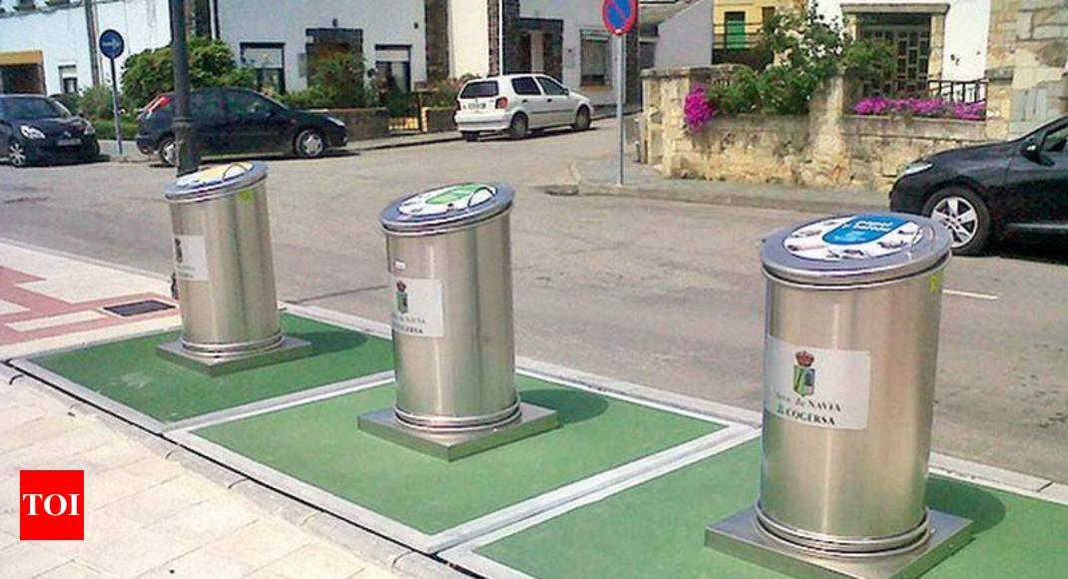
AIM
The government provides different trash cans so that people can dispose of garbage according to the type of garbage and waste will be easily recycled, and this is done in order to be a smart city.
However, there are some people who do not understand in which vats they have to dispose of so that in the end they immediately throw garbage in any barrel without seeing the type of garbage in each trash can.
This study aims to create a trash can that can determine the type of waste that is discarded and automatically dispose of it in the right barrel.

Slide 6
Testing :How smart dustbin helps in waste management process
Smart dustbin helps the people to identify the type of waste and separate them according to the type of waste.
The smart bin ensures collection only when the container is full. It reduces your efforts and time too.
It is very important to prevent the waste that is present every where on the land. This will help the people to know more about the waste which can be helpful for plants and which can be recycled.
Few smart bins come with a WiFi facility, as a result of, increase in hotspot coverage for the public.
This smart Bin move improves street hygiene and safety.
They also encourage recycling and reusability.

Slide 7
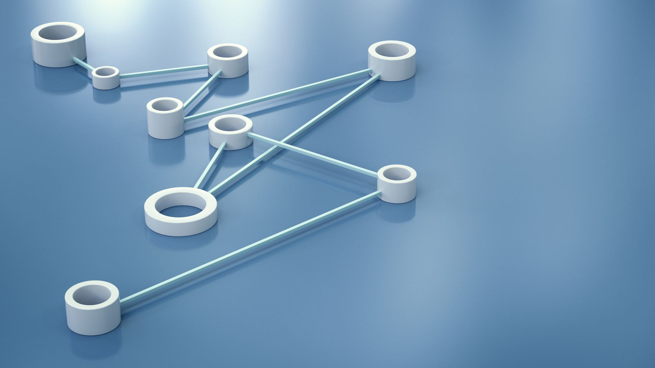
High Fidelity Prototype:
https://www.youtube.com/watch?v=9yrP1CZN3Ds

Slide 8
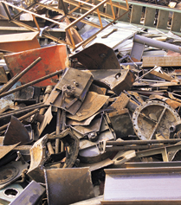
Our Most Important Learnings
When we destroy the environment by human doings , we are destroying future life and their well being. As a present generation, we have the responsibility to turn this around.
The most important aspect of waste management is we if do not take any measures degrading this problem their will be a lot of troubles.
Some of them are their will be waste present every where, all the places will be filled with waste like oceans, rivers, land, etc. The whole nature and environment will be filled with waste. This leads to contamination of food, water which leads to many diseases.

Slide 9
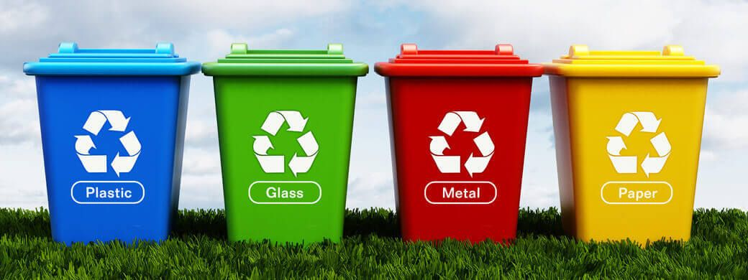
Entrepreneurial Skills :
is a startup hoping to create a smart city. Our startup also involves different trash cans so that people can dispose of garbage according to the type of garbage and waste will be easily recycled, and this is done in order to be a smart city.
We want to develop a making a smart trash can prototype to be implemented in smart city based on arduino and android. Which later can also be a device for education about the type of garbage in children from an early age.
BUDGET: Approximately Rs.1,00,000

Slide 10
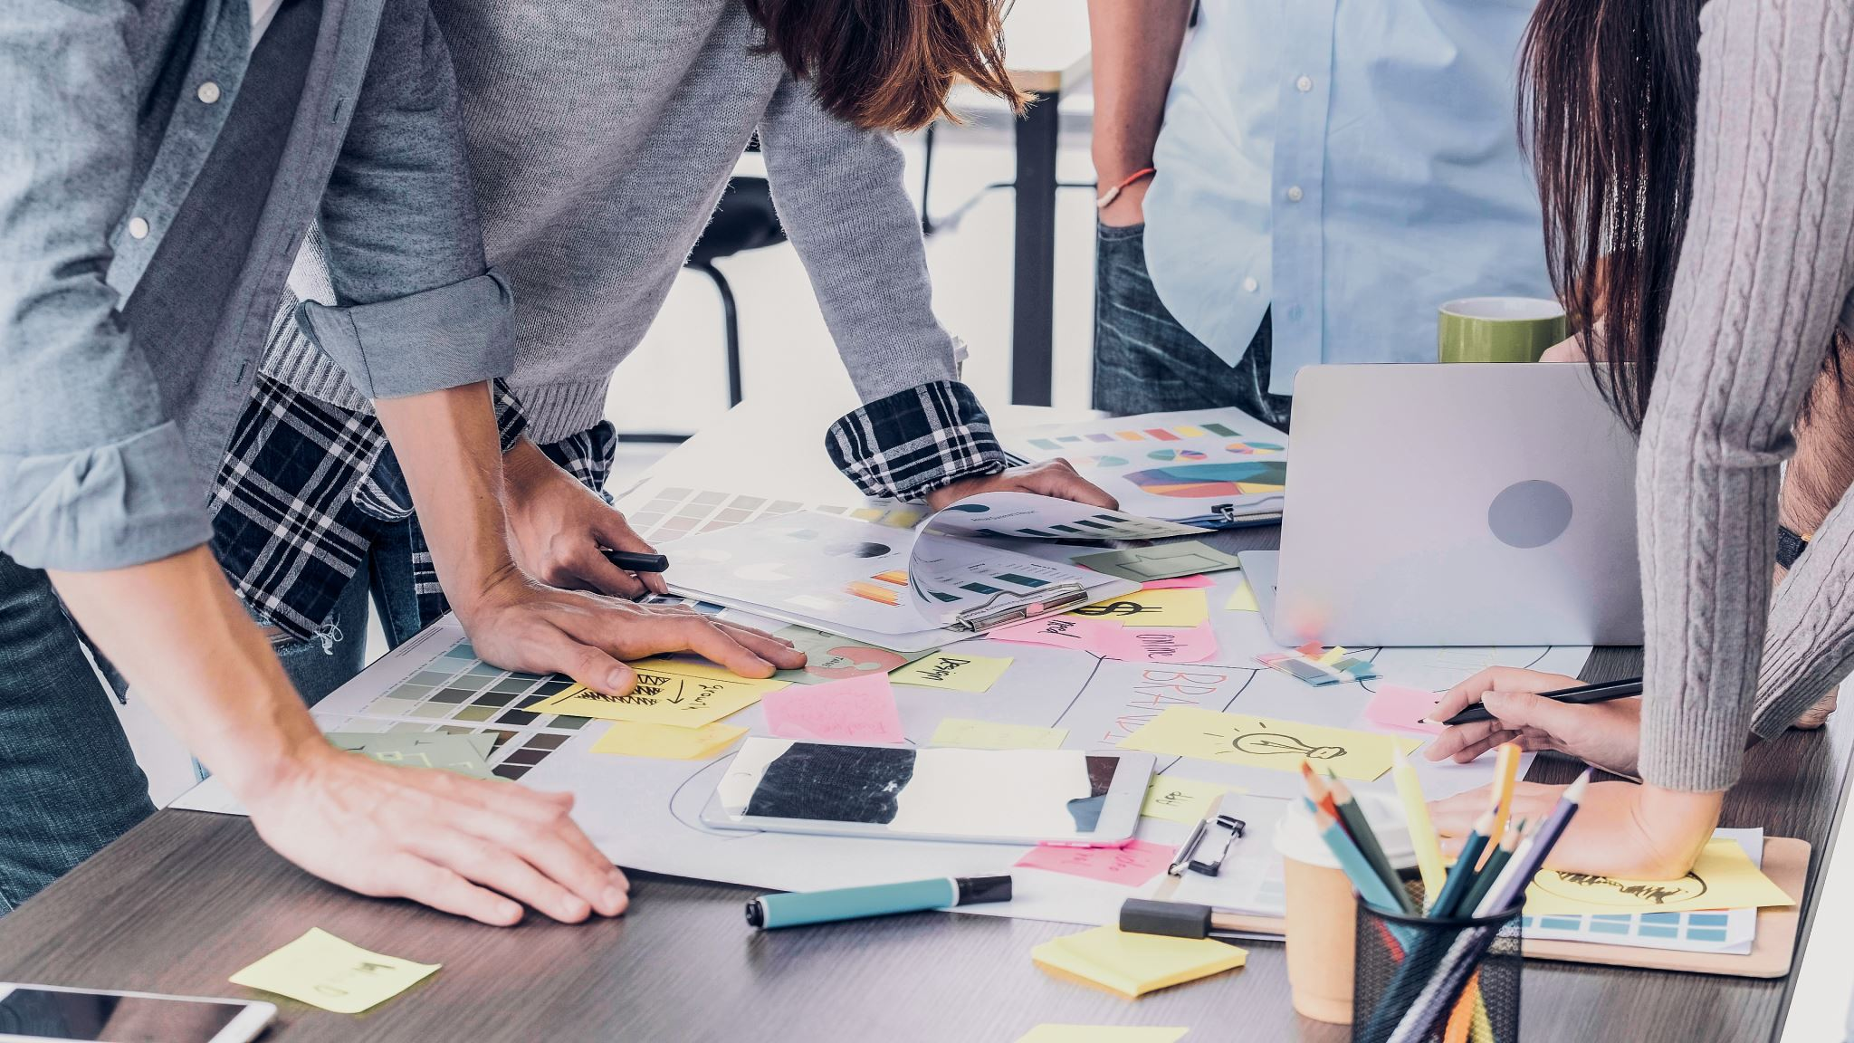
Things we Learned about transforming Design Thinking to Start-up
Learn to apply design thinking fundamentals to ensure that a solution is desirable from a human point of view and aligns with what is technologically feasible and economically viable.
Develop an in-depth understanding of the full design process from inspiration to implementation and learn to transform an idea into an innovative product or service.

Slide 11
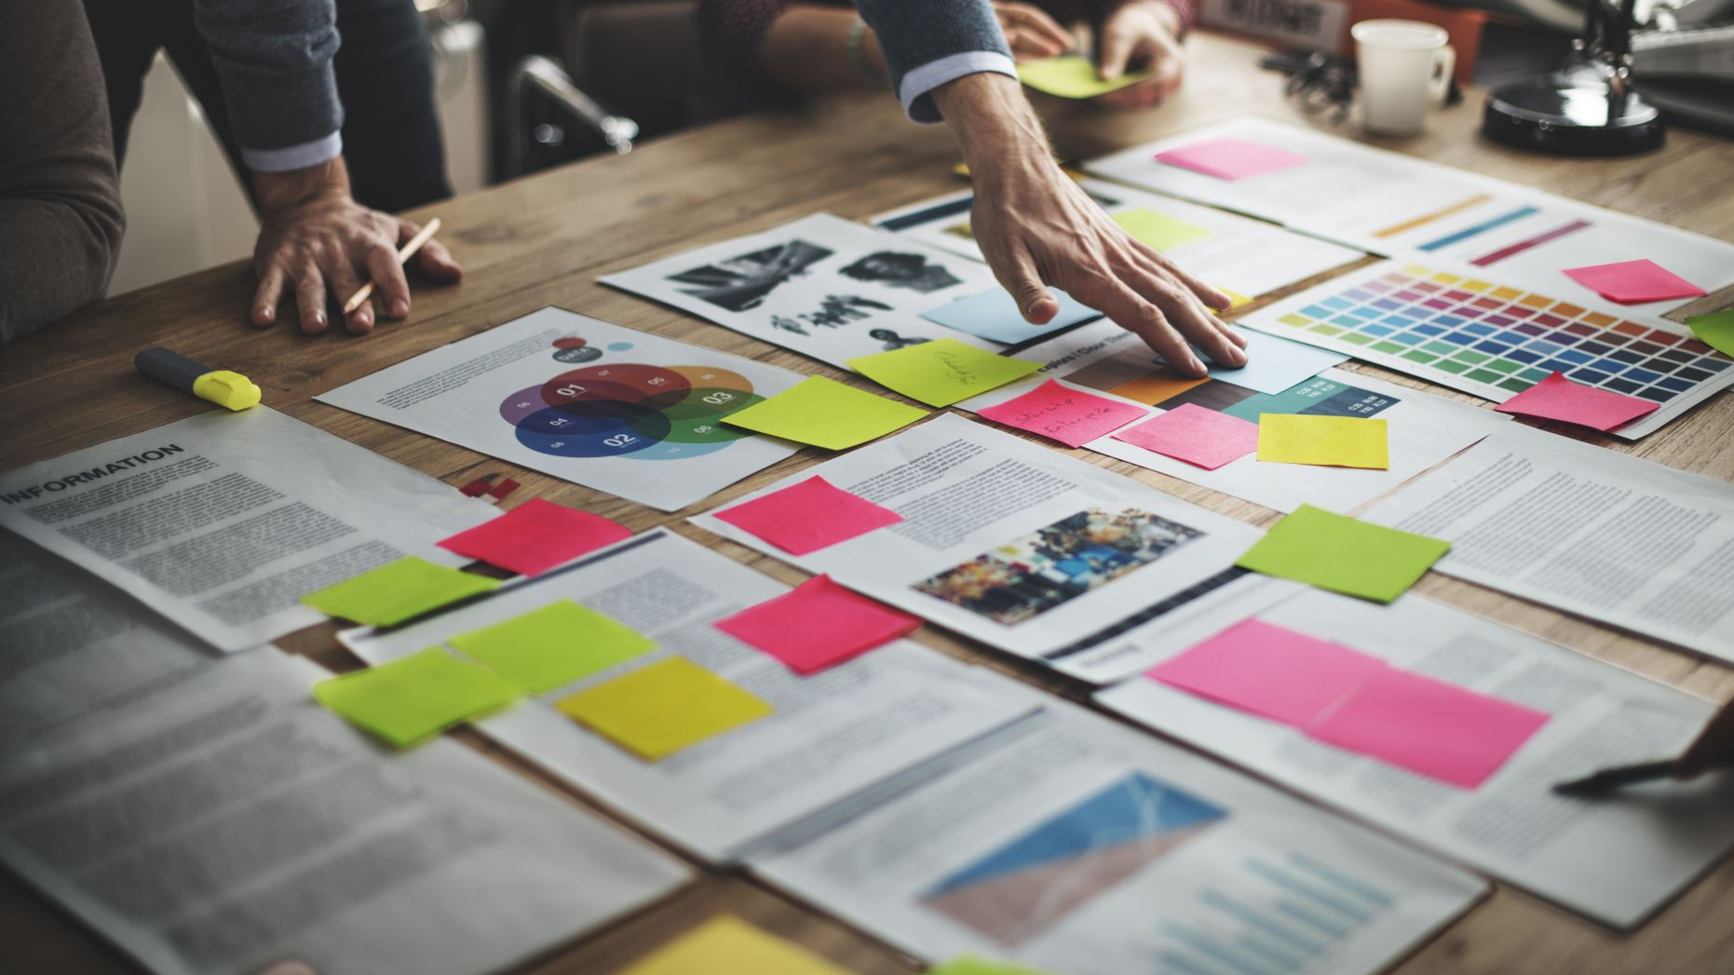
Things we Learned about applying Design Thinking in future.
Design thinking nurtured our individual creativity, help us overcome resistance to new ideas.
Implement design thinking as a rigorous, human-centered approach to creative problem solving.

Slide 12


